Slide 1
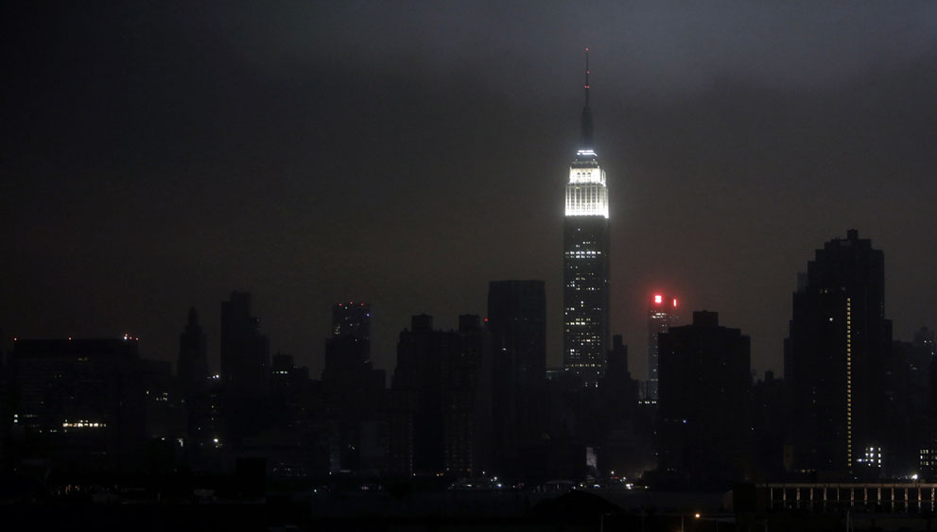
Everbridge
Mass Notification Interactive Visibility
Presented by
Soraya Sutherlin
Emergency Services Coordinator
Torrance Police Department

Slide 2
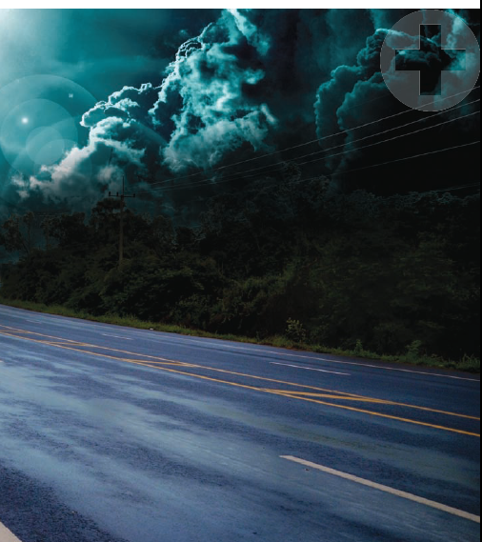
Asking the WHY?
Notes:
We have to ask why? Why does this matter? What has happened on the national level to change policy, directives, and culture? The next few slides illustrate the need for what and how we communicate to our community.

Slide 3
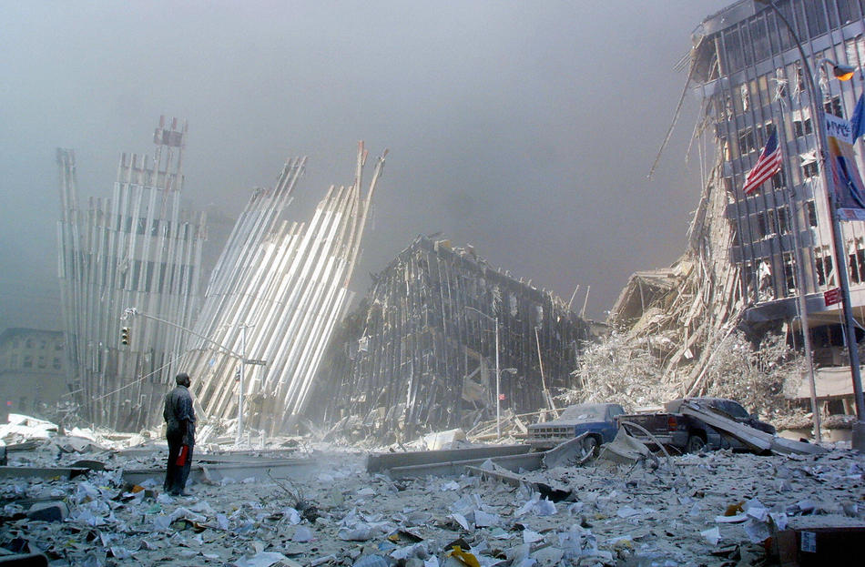
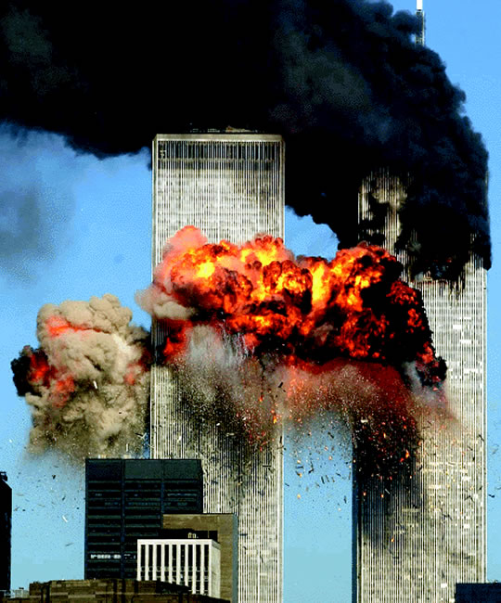
World Trade Center September 11, 2001

Slide 4
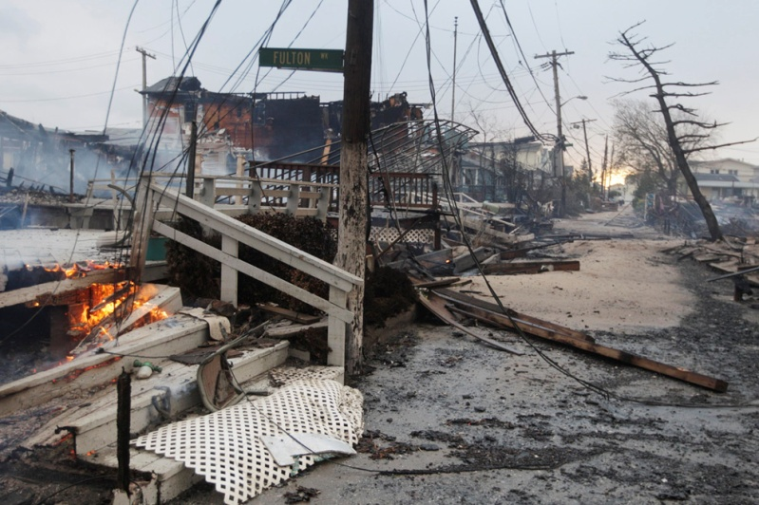
New Jersey Hurricane Sandy, 2012

Slide 5
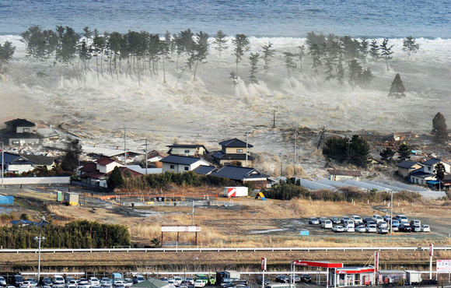
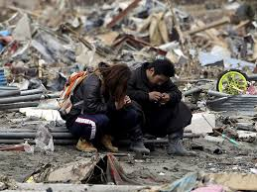
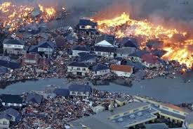
The Great Japan Earthquake and Tsunami, 2011

Slide 6
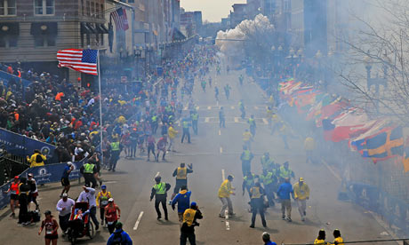
Boston Marathon Bombings, 2013

Slide 7
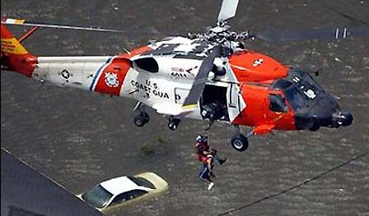
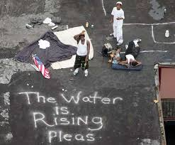
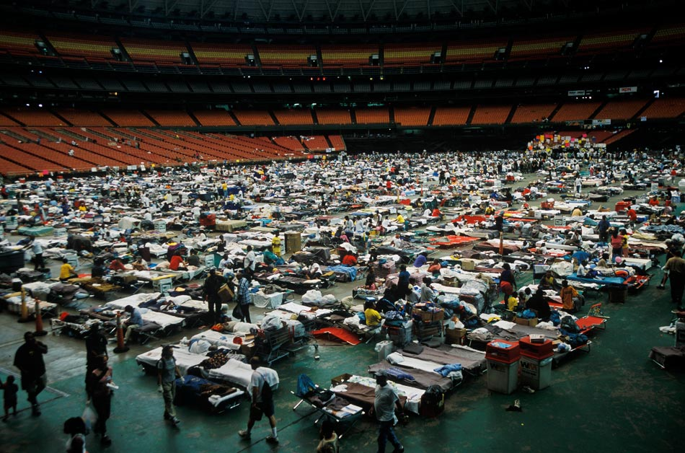
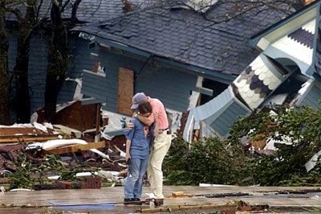
Hurricane Katrina, 2005

Slide 8
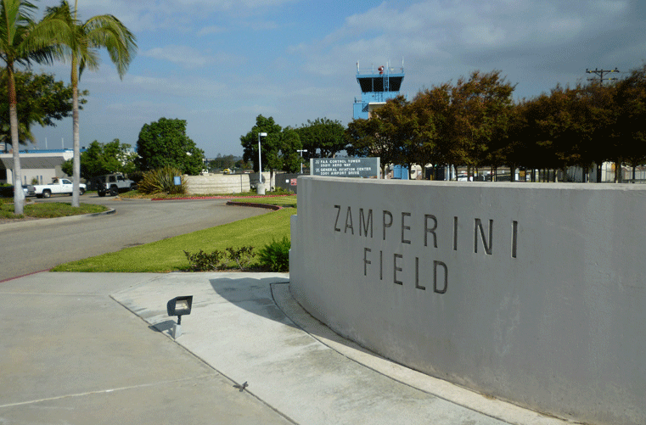
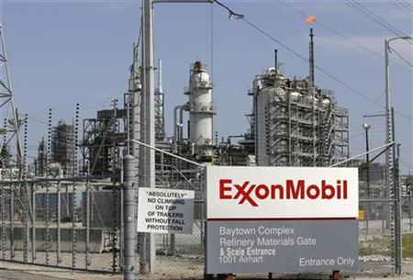
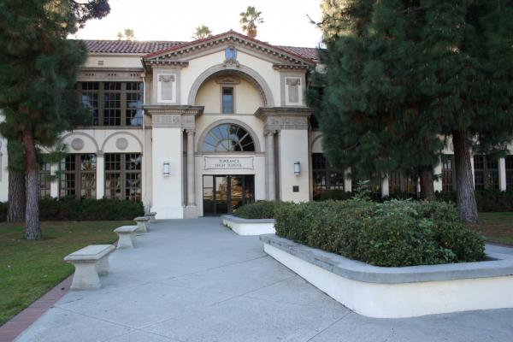

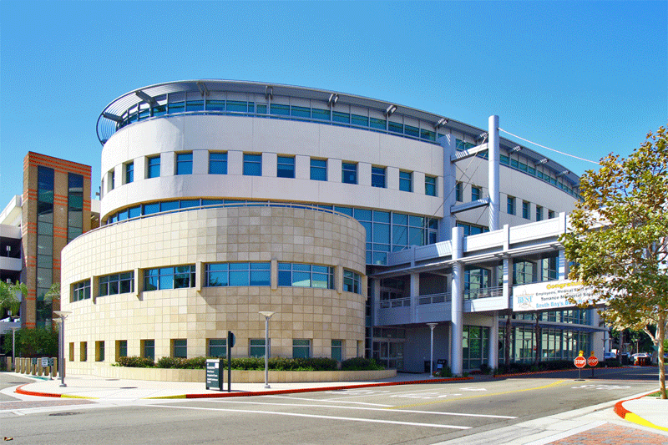
Torrance, Ca, 2014

Slide 9


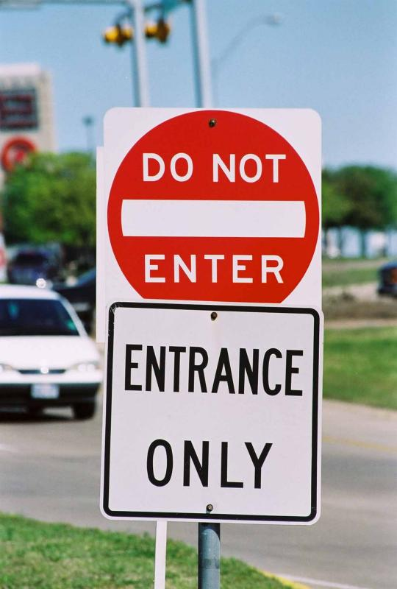
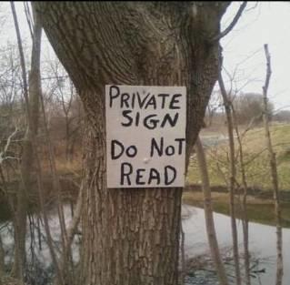
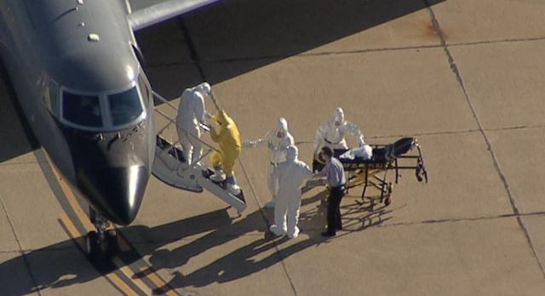
Challenges
Commonality between all disasters are communication breakdowns
  Too much
  Too little
  Too late

Slide 10
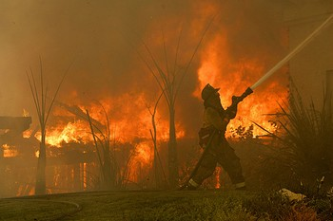
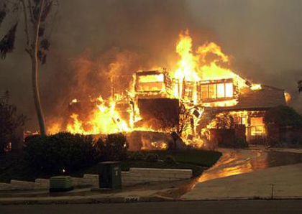
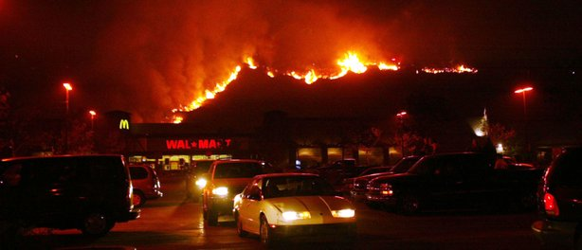
Background
2003 San Diego Fire Storms
  No Reverse 9-1-1 system in place
  15 deaths
  2,000 homes destroyed
  56,000 evacuated
Notes:
During Southern California's 2003 blazes, 15 people died, more than 2,000 homes were destroyed and just 56,000 people were evacuated. Some residents never received a notice to evacuate. That's not surprising considering the methods used for evacuation, which consisted of law enforcement personnel knocking on doors and notifying residents from loudspeakers.
The key to Reverse 911 is it's essentially an electronic knock on the door from the sheriff, instead of relying on sheriff's loudspeakers and going door to door to let people know as in 2003. We had many people die in their garages or in their escape routes in 2003. The fires just move so fast and there are only so many deputies, you can't be everywhere."

Slide 11
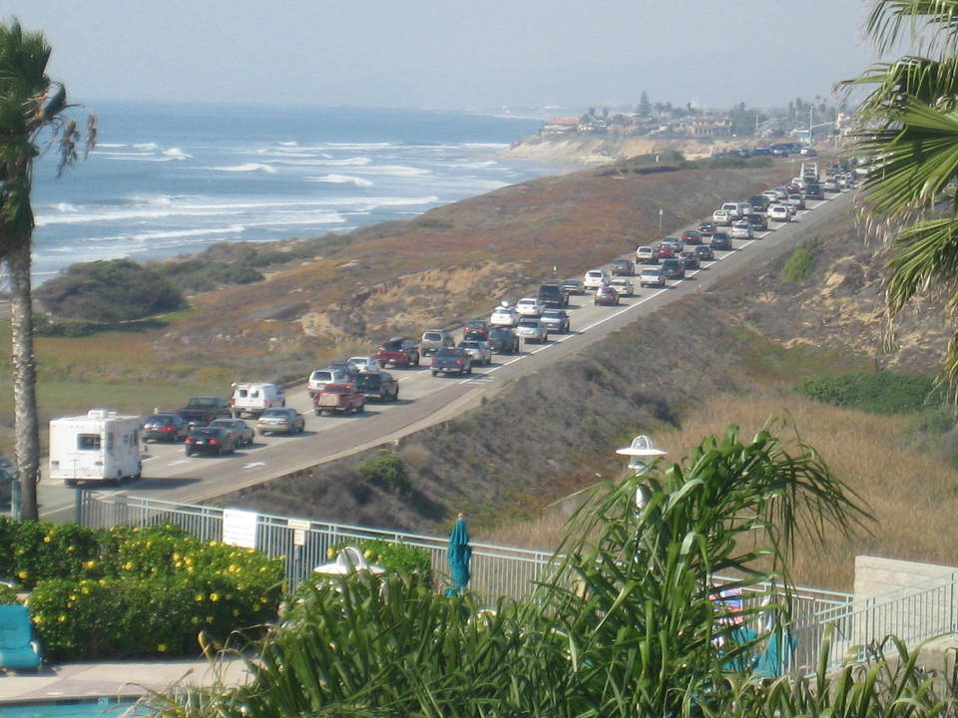
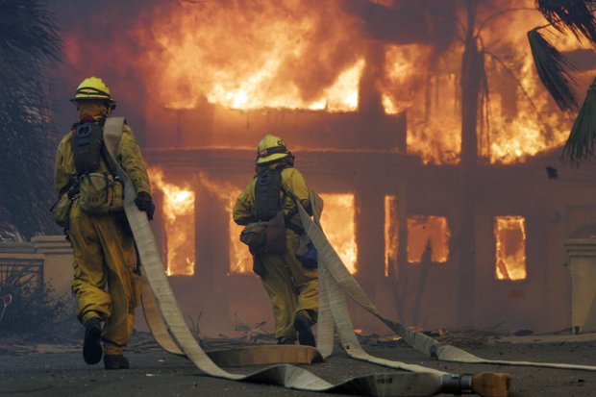
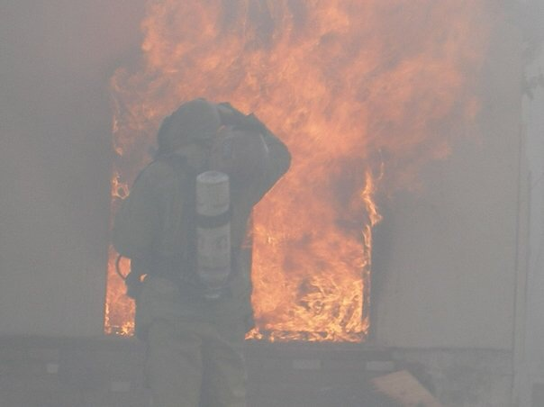
Case Study
2007 San Diego Wildfires
  377,000 evacuation calls
  20,000 sheltered
  Situational Awareness

Slide 12
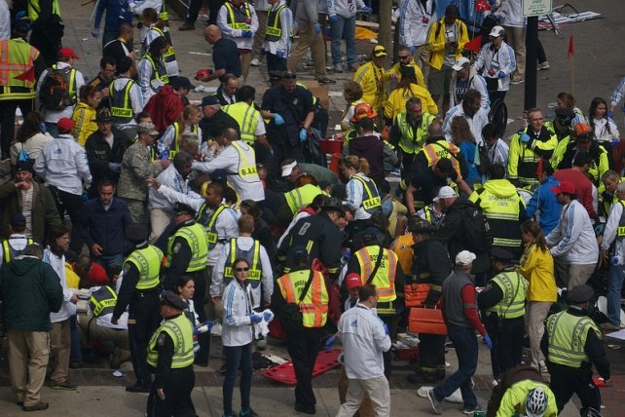
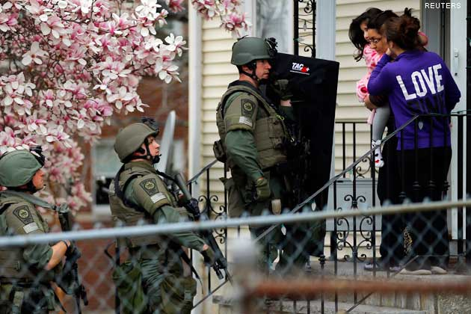
Case Study
2013 Boston Marathon Bombings
  Recalled emergency responders;
  Mobilize critical resources and command post;
  Verified safety of employees and students (Harvard and Pearson);
  Sent “shelter-in-place” city-wide messaging while the search for the shooters ensued.
Notes:
Lessons Learned from the Hospitals: Adopt a mass notification system. “It would have diminished the rumors and increased the clarity of what was really happening in a much faster way,” says Michelman. “We were sending out mass E-mails to everyone, but not everyone was reading their E-mails. People would have understood what was closed, what was locked, where people should park, where people should come in, why SWAT was outside.
ven as phone lines jammed with an influx of calls from anxious friends and relatives trying to reach their loved ones in Boston on Monday, Everbridge’s software was able to bypass overloaded cell towers by using land-based phone lines and Wi-Fi signals to send alerts to phones, e-mail addresses, pagers, faxes, even electronic billboards or road signs.

Slide 13
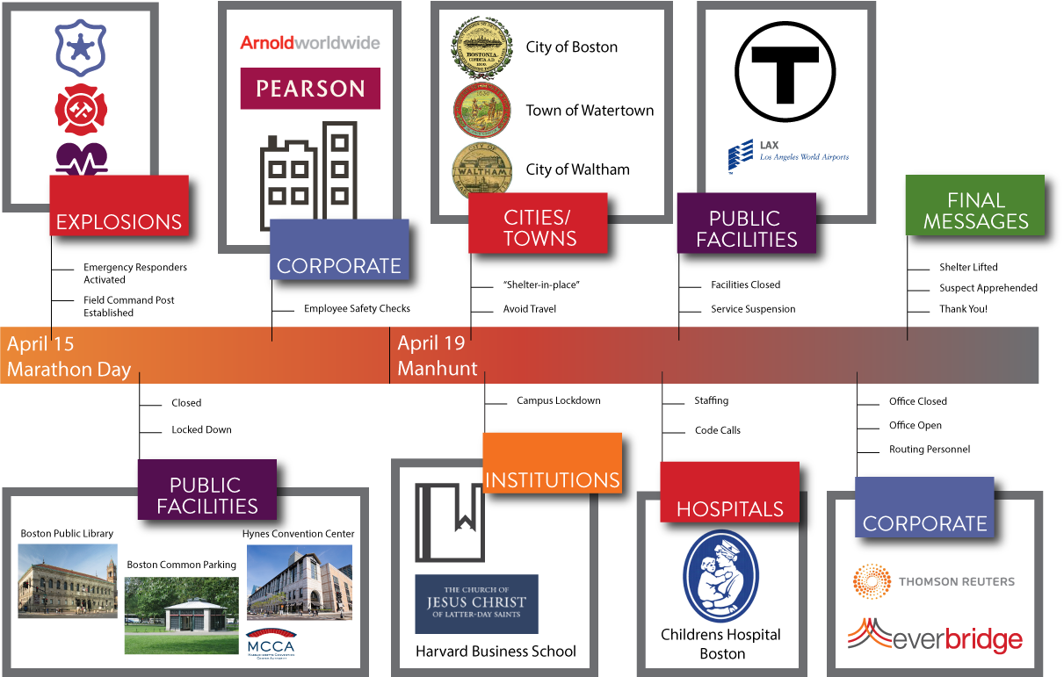
Network Effect for Boston Marathon Bombings

Slide 14
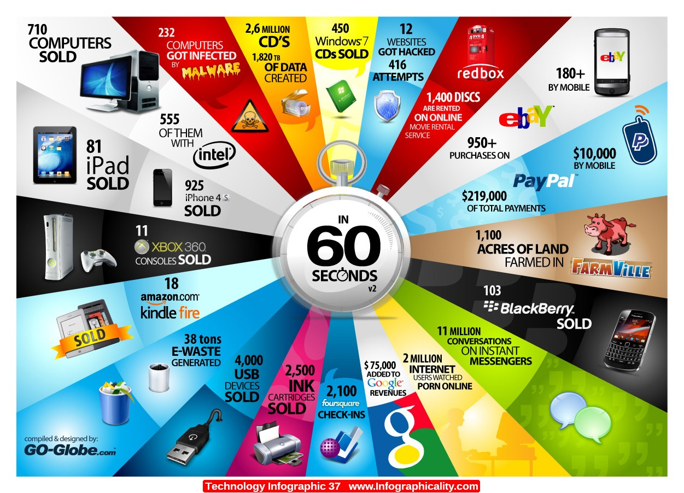
What’s Changed?

Slide 15
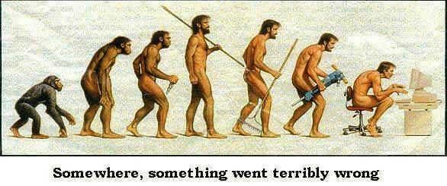

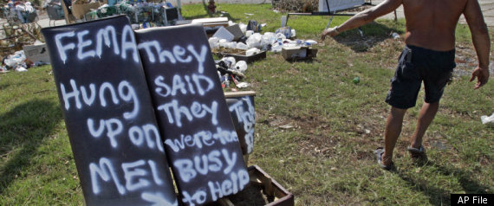
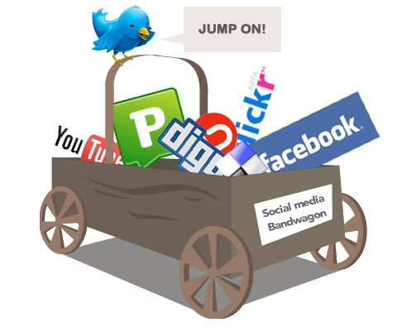
What’s Changed?
Dynamic Shift in information sharing and management;
Public expects a dialogue between the City and its constituents;
Public expects information almost instantly after a disruption has occurred;
If the message is not managed early and effectively across multiple communication platforms, you will loose the event;
Social Media.
Notes:
Technologic advancements, the cellular movement, and social media has changed the way we communicate internally and with our community. If people aren’t given information, they will make it up.

Slide 16
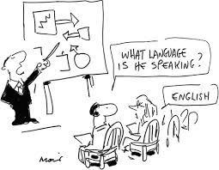
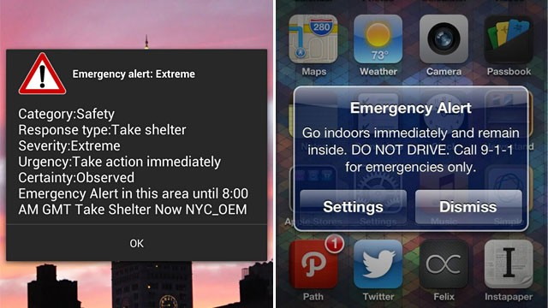
What is our Goal?
Communicate imminent threats to life, property, or the environment to our community;
  Right message, to the right person, at the right time.
Engage our residents and businesses in non-emergent situations through an interactive platform that allows for a two-way dialogue;
Instill trust and confidence in our ability to prepare for, respond to, and recover from emergencies and disasters.
Notes:
If you don’t provide information, they will make it up. The goal is the right message, to the right person, at the right time.

Slide 17

Everbridge Platform
Flat-rate use system-unlimited messaging;
Web-based, no software required
Targets the individual, not the device;
Allows for delivery to multiple communication platforms;
  Allows for customization for user delivery methods;
Allows for two-way dialogue between the sender and receiver;
Notification escalation;
Offers text-to-speech conversion including language conversion;

Slide 18
Everbridge Platform
Allows for select messaging to pre-identified groups such as AFN, CERT, etc.
GIS-based message targeting;
Customization with caller ID, message, and voice;
Ability to create user groups, units, and distribution lists for non-emergency notifications;
Automatic publishing to social media accounts;
Provides redundancy and continuity of government operations if physical infrastructure is damaged or destroyed;
Provides situational awareness in the EOC or Command Post.

Slide 19
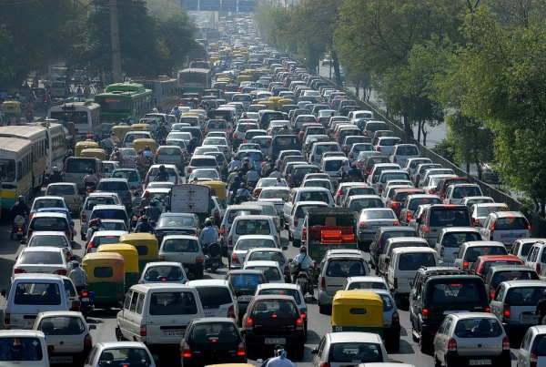

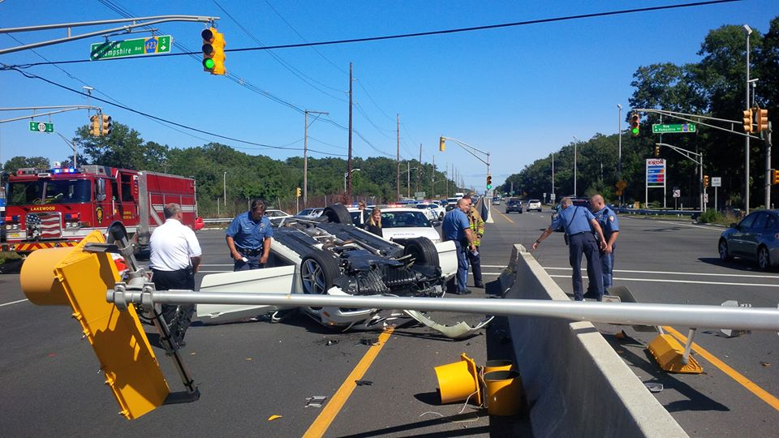
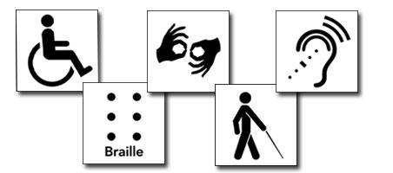
Connecting our Community
(through the Opt-in Program)
Traffic Alerts;
Transit Delays;
Community alerts and events;
Schools and Churches;
Hospitals, Surgical Centers, SNF’s;
Local businesses;
Access and Functional Needs.
Notes:
This is going to allow for our community to communicate with us real time on their needs. They will have the ability to tell us what resources they are dependent upon for survival to include access in and out of the community, medical needs, and support mechanism.

Slide 20
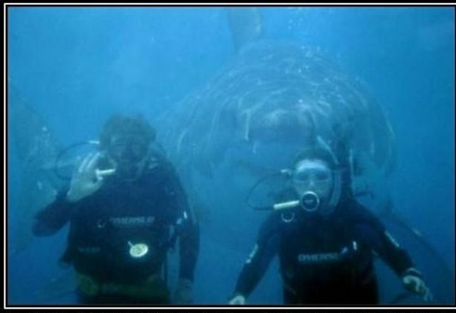
Situational Awareness
Notification of appropriate personnel;
Response coordination for effective management of situation;
Public messaging and expected action;
Short and long-term impacts to our community.
Notes:
Everyone's situational awareness is different. We all see things from a different set of eyes and perspective. Gathering this information in crisis situations is critical to your response efforts and safety of responders and bystanders.

Slide 21
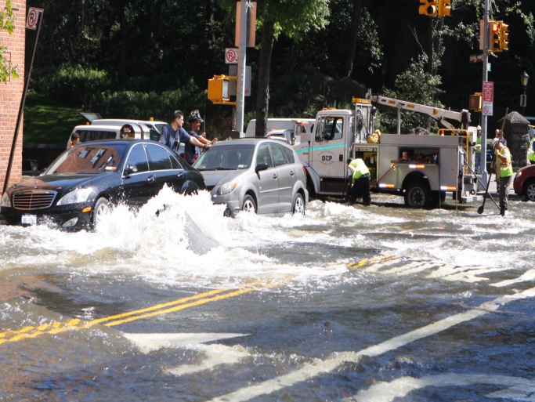
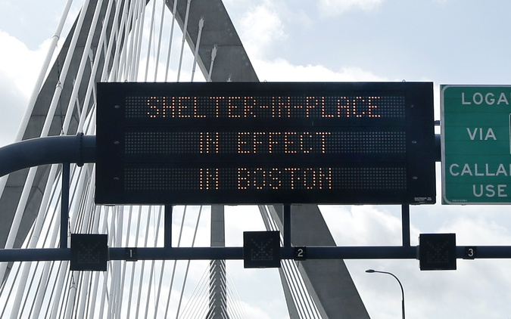
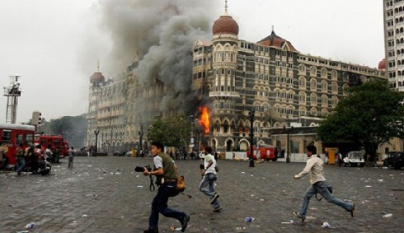
Examples
Water main break, contamination, water loss;
Shelter-in-place;
Active Shooter event;
Fire;
Flooding;
Hazardous Materials;
Terrorism.

Slide 22





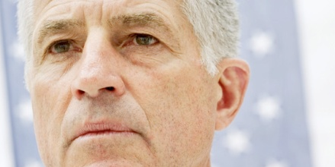









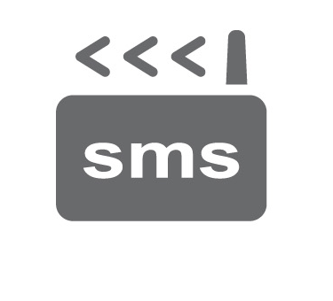




Connectivity and Accountability
Alan
Sue
Dave
Phil
Janice
Kathy
Tom
Julie
Fred
First Attempt
Mike
✓
✓
cell
work
text message
email
cell
text message
email
CONFIRMED
4/20/09 10:02:03 AM
work
BlackBerry
CONFIRMED
4/20/09 10:02:56 AM
BlackBerry
Second Attempt
✓
work
cell
BlackBerry
cell
cell
BlackBerry
work
CONFIRMED
4/20/09 10:03:35 AM
work
Third Attempt
✓

text message
email
email
instant message
pager
PDA
pager
NO RESPONSE
CONFIRMED
4/20/09 10:04:15 AM
Re-send?
Notes:
Some notification solutions blasts messages to all contact devices and on all contact paths. The most effective approach uses a sequential, targeted process where each contact path is prioritized sequentially and once a notification is confirmed, the broadcast stops.
You can designate the number of attempts per broadcast, the duration of the broadcast, the interval between each transmission, and you need to have the flexibility to resend the broadcast if needed.
How the process works:
1. Administrator log on to the system via the internet, via any web-enabled portable device, or by calling an automated attendant or a 24/7 live operator.
2. Users create messages for broadcast or access pre-written scenarios that have been pre-loaded/saved into the system.
3. The mass notification system rapidly broadcasts the message out to members, attempting to reach them on their preferred pathway first. If confirmation of receipt is not received...
4. …the system cycles through users’ other contact paths, attempting to contact them in their preselected order of preference.
5. When members receive the message, they are prompted to confirm its receipt or respond to polling questions sent by administrators using their touch-tone pad. For voice, the touchpad is used to confirm by pressing “1”, for text/SMS the recipient is asked to click on a link.
6. Real-time reports on confirmation rates and question responses are instantly relayed back to the administrator.

Slide 23
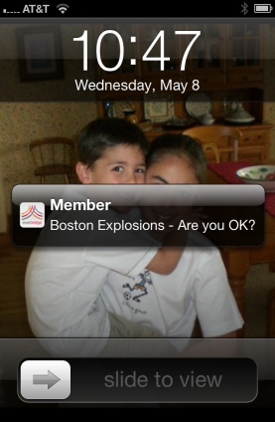
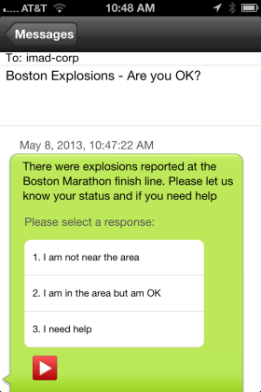
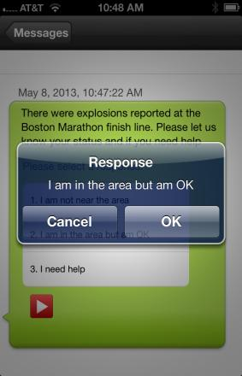
Mobility: Mobile Member
  Communicate with and geo-locate frontline resources even under adverse network conditions like low bandwidth or connectivity
  Receive push notifications
  Respond using polling
  Share details & photos
Notes:
Potential Pains
*No way to establish two-way communications with employees
*Need an effective alternative to SMS
*Difficulty transmitting using low bandwidth connections
*Challenging to gather photo intelligence to understand the impact of an incident (fire, weather, accident, explosion, etc.)
Additional Discovery Questions
Does your current notification system have a mobile application so multiple responders can securely send notifications and receive real-time reporting?
How do you currently communicate with frontline resources to understand what is happening?
Do you have a push notification path available to you as an option for communications? Have employees ever asked to receive push notifications over emails or phone calls?
Business value:
Improve Field Communications – Communicate and capture detailed geographic and visual feedback from mobile employees
Improved Situational Awareness - Enables decision-makers to simultaneously gather intelligences and communicate efficiently to Mobile Member recipients
Key capabilities:
*Send and receive messages from your mobile network that include geo-location information, pictures, and free form text.
*Geo-locate mobile network members
*Deliver push notifications to your network
*Include polling responses to gather information as part of broadcasts
*Designed for use under adverse network conditions (aka low bandwidth/ connectivity)
*Available for Apple® iOS and Android™ users.
*Allow Mobile Member to send solicited and unsolicited messages including geo-location information and pictures

Slide 24
Final Thoughts- The Message is Real
  How the community will react depends largely on the confidence we present after a disaster or emergency;
  The frequency of messaging will instill public’s trust and confidence in our ability to manage the incident;
  Social Media will run the incident if we don’t control the message early;
  Engagement of community groups and businesses on the front end will help instill resiliency in our community after a disaster.

